Slide 1
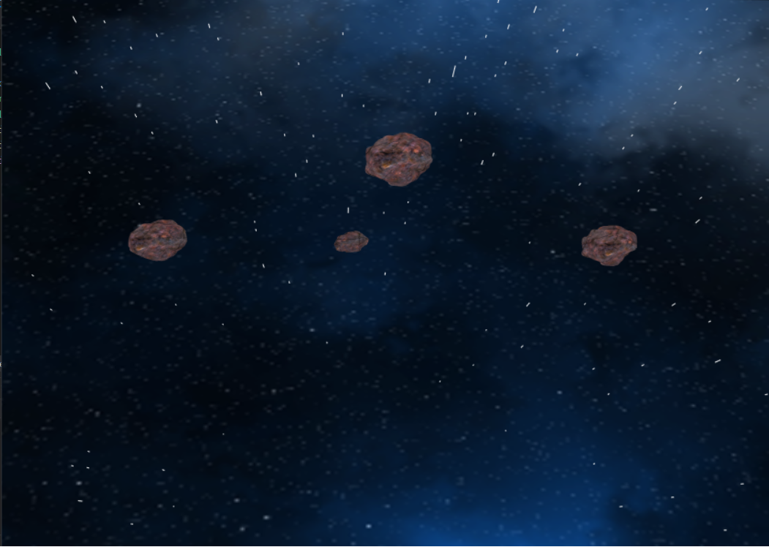
NIGHTFALLS
Computer Graphics Object modeling and Rendering project

Slide 2
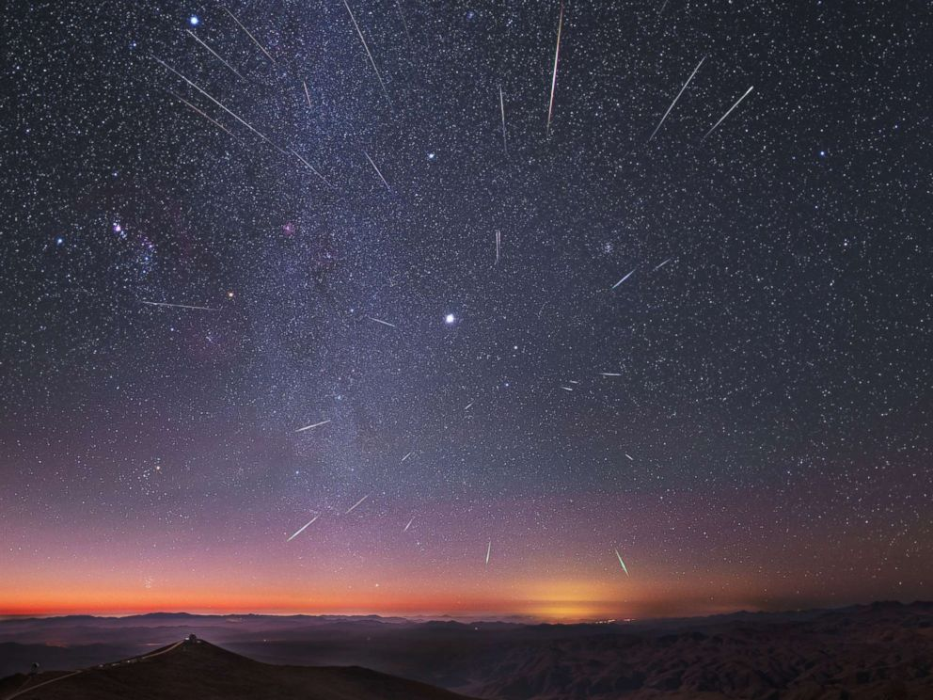
Meteors
Meteor showers take place regularly and are one of the most fascinating phenomenon

Slide 3
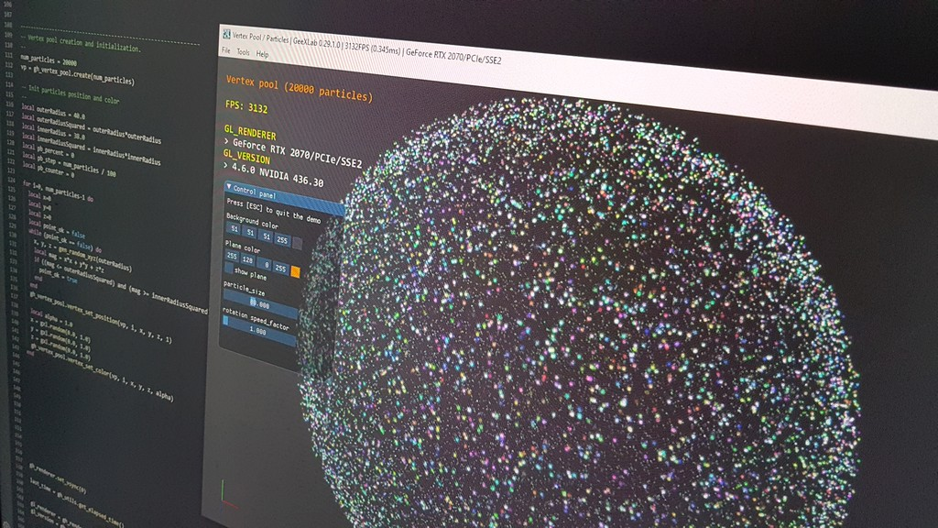
OPENGL
A cross-language, cross-platform API (Application Programming Interface) used for rendering both 2D and 3D graphics.
Legacy OpenGL refers to the primitive version of OpenGL, especially those previous to 3.0
Legacy OpenGL doesn’t give user access to Vertex Buffers and thus has poorer performance
Nonetheless, it has better compatibility and is still strong enough for Many projects
Legacy
3

Slide 4
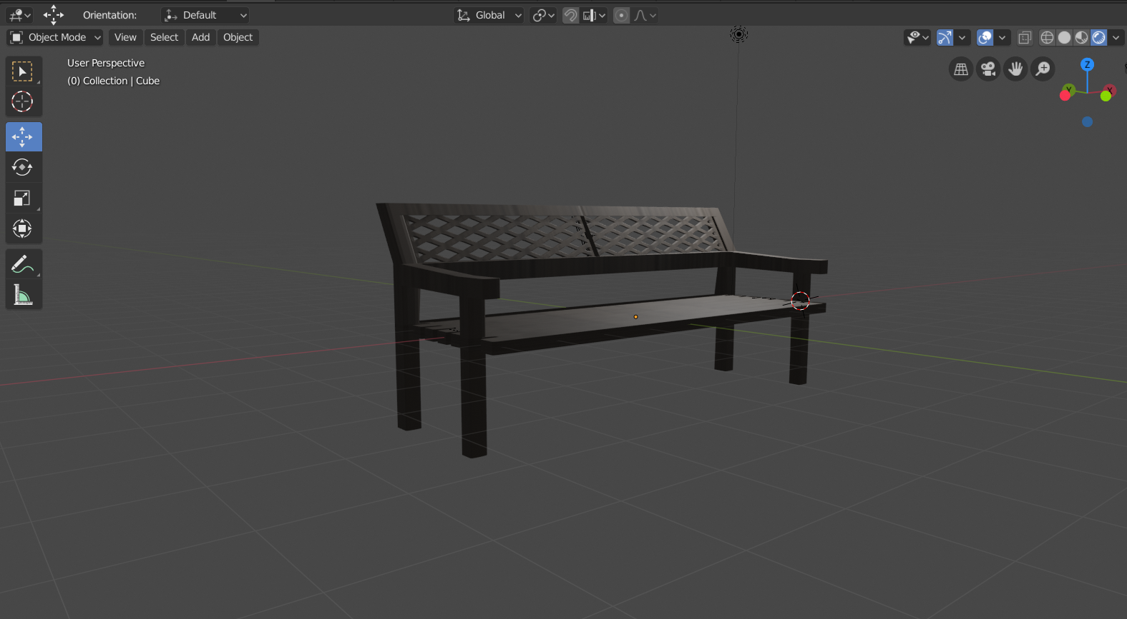
BLENDER
A free professional grade 3D working suite that is fully fledged for industry standard Graphics
4

Slide 5
SDL AND VISUAL STUDIO 2019 COMMUNITY
Simple DirectMedia Layer is a cross-platform development library designed to provide low level access to audio, keyboard, mouse, joystick, and graphics hardware via OpenGL and Direct3D.
It is used by video playback software, emulators, and popular games including Valve’s award winning catalog and many Humble Bundle games.
Visual Studio is an Integrated Development Environment(IDE) created by Microsoft to create GUI(Graphical User Interface), reassure, Web applications, web applications, versatile applications, cloud, and web administrations, and so forth.

Slide 6
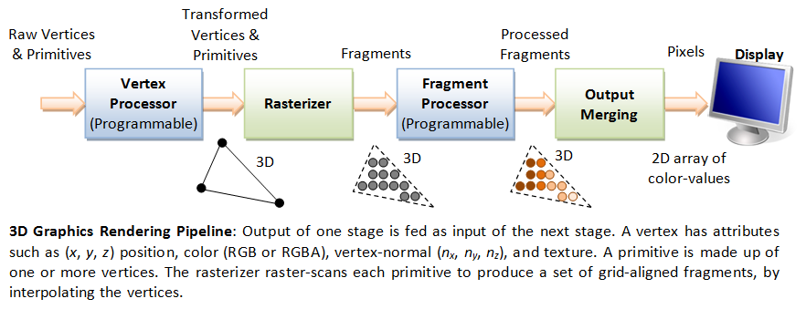
OpenGL 3D Working Pipeline
The 3D graphics rendering pipeline consists of the following main stages:
Vertex Processing: Process and transform individual vertices.
Rasterization: Convert each primitive (connected vertices) into a set of fragments. A fragment can be treated as a pixel in 3D spaces, which is aligned with the pixel grid, with attributes such as position, color, normal and texture.
Fragment Processing: Process individual fragments.
Output Merging: Combine the fragments of all primitives (in 3D space) into 2D color-pixel for the display.

Slide 7
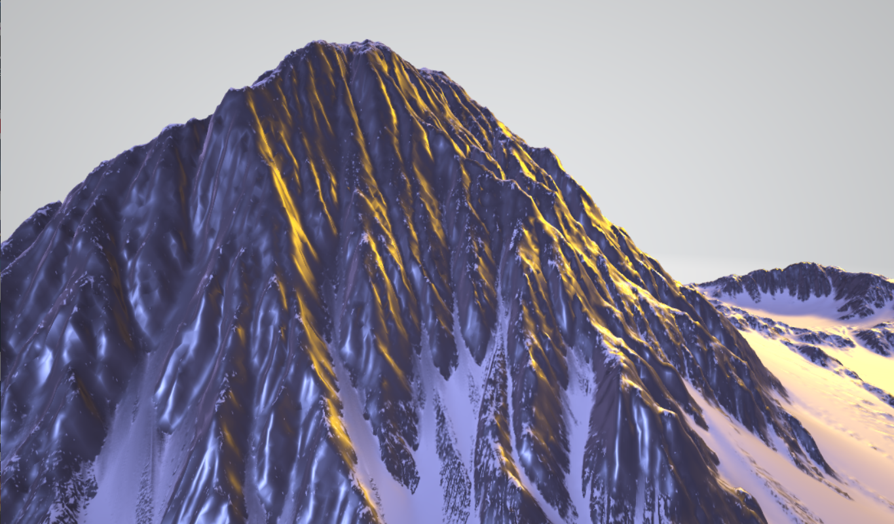
TEAM AND WORK DIVISION
Jebish Purbey
074BEX412
Manita Dahal
074BEX414
Nimesh Rai
074BEX415
Paru Hang Rai
074BEX416
Modelling – House
Coding – Main file and Object loader
Modelling – Bench and Terrain Modelling
Coding – Camera Movement
Modelling – Trees
Coding - Skybox
Modelling – Meteors
Coding – Particle system

Slide 8

Object Loader
Loads object with just load(“filename.obj”);
Usage of vector for efficient vertices transfers, using pushback function
Loads texture and materials details from .mtl file
Usage of Texture filter for better texture mapping

Slide 9
OBJECT Loader
Start
Declare and define all possible variables required for loading objects
Load each line of object file in the character buffer
If the initial characters of buffer says Texture, read the texture from mtl file and load using loadtexture function
Draw the model while it’s object is being parsed
Load object loaders load function with a “obj” file
END
Check the initial characters of the buffer for the type of parameters
If the total file has been read then end the function and model is displayed
If the initial characters of buffer says change of material, read the new details from mtl file and send to attribute variables
Delete the textures once its used for prevention of memory leak
Declare a buffer of maximum 255 characters
Send the data with the correct format in the required variable field

Slide 10
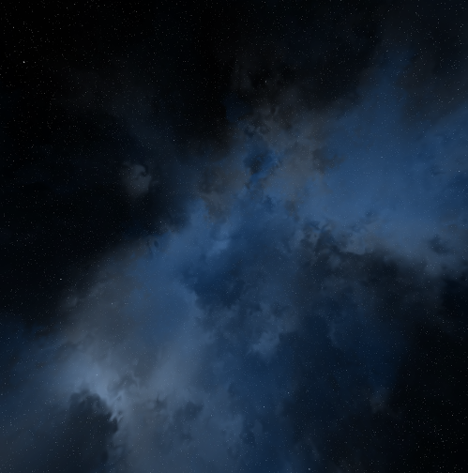
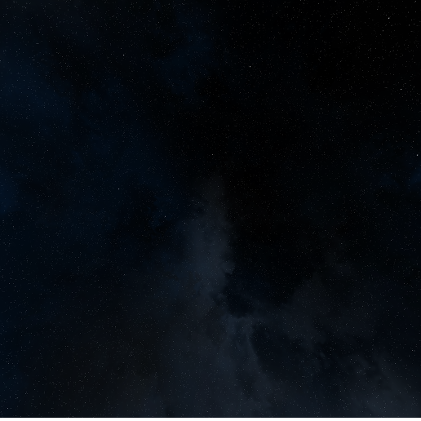
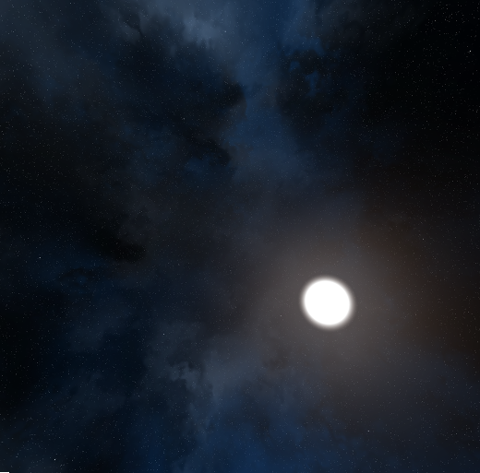
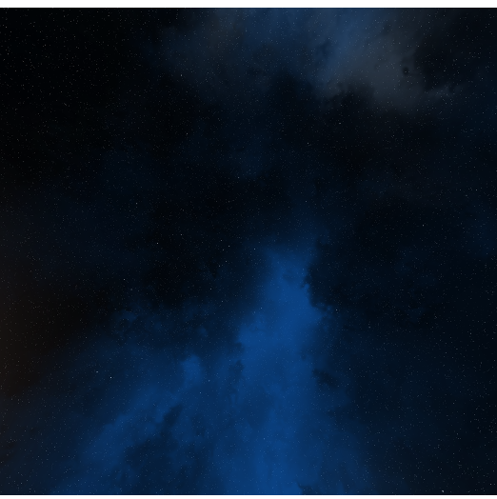
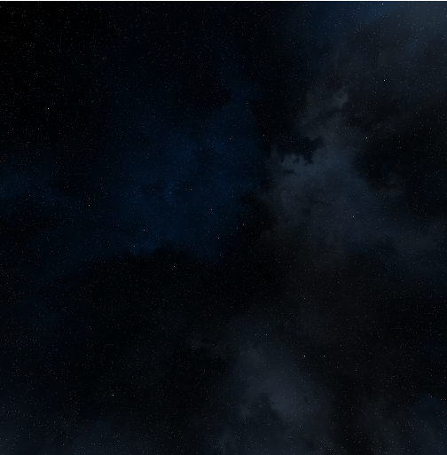
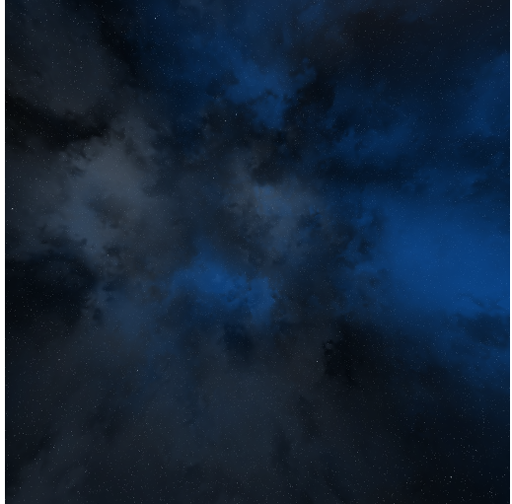
SkyBox
A six sided cube with texture that gives life to the environment
Usage of array for storing texture ID for each side
Loads textures using loadtexture() function
Sometimes light sources interferes (blends) into the skybox, so it’s recommended to disable the light source before drawing the skybox

Slide 11
SKY Box
Start
Disable the lights
Starting from one side of skybox, generate the texture, and bind it
Do the same for the remaining 5 sides
Initialize an array to load all the six textures of skybox
End
Draw the quads for that textured side with help of vertex(3D) and textured coordinates
Enable the lights
Load the texture ID to the respective elements of array

Slide 12
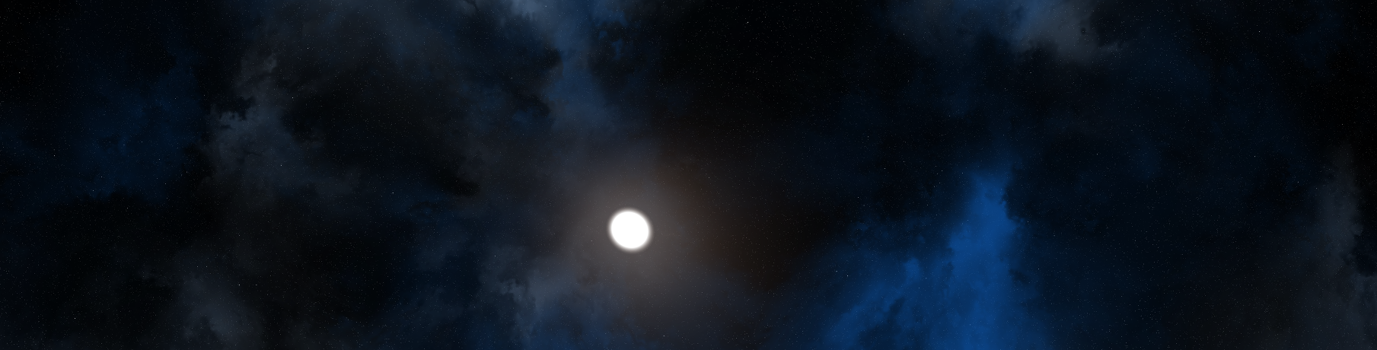
Camera Movement
Uses SDL library for Keypress and mouse detection
W S A D gives movement
Mouse movement rotates the camera : camera Yaw and Camera pitch
“P” key enables/disables the camera movement

Slide 13
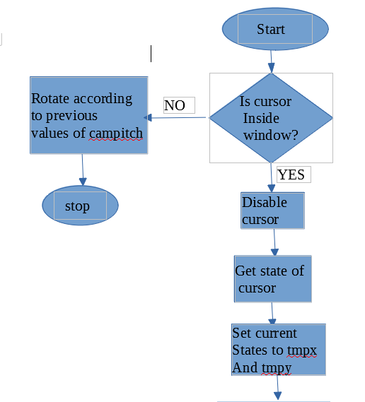
CAMERA Movement
Fig: Block Diagram to show creation of Skybox in OpenGL

Slide 14
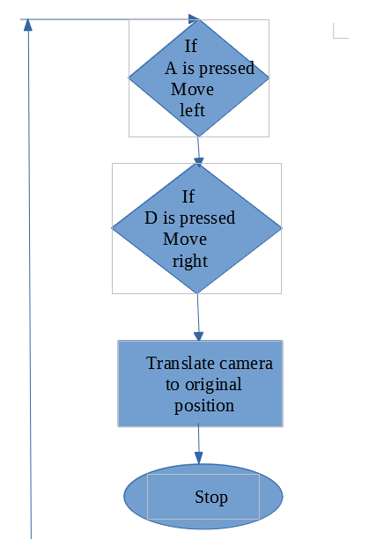
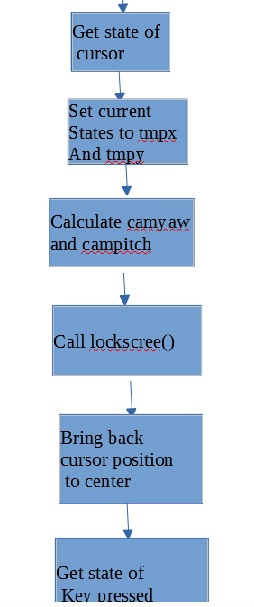
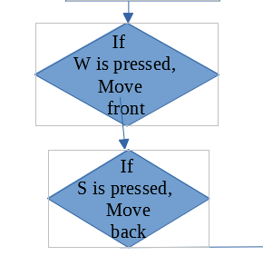
CAMERA Movement
Fig: Block Diagram to show creation of Skybox in OpenGL

Slide 15
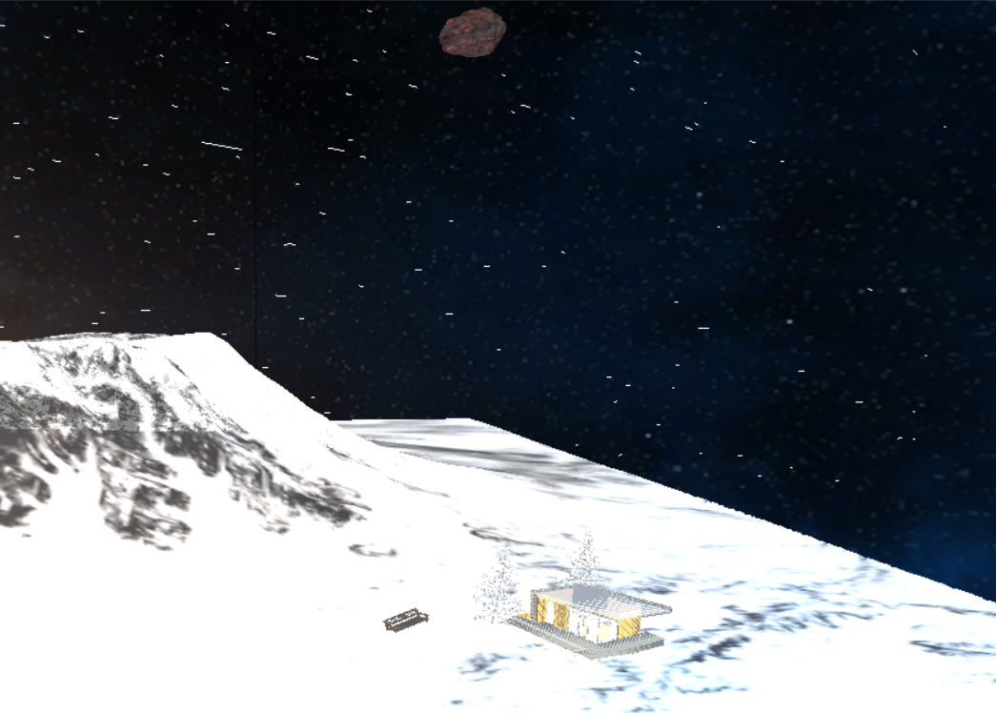
PARTICLES System
Uses glBegin(GL_LINES/GL_POINTS) for drawing the particles
A particle system is a technique in game physics, motion graphics, and computer graphics that uses many minute sprites, 3D models, or other graphic objects to simulate certain kinds of "fuzzy" phenomena, which are otherwise very hard to reproduce with conventional rendering techniques.
Usually chaotic phenomena are represented by particles
Particle has Position, updated positions, velocity, gravity and acceleration due to mass

Slide 16
PARTICLES System
B
Is velocity >max_velocity
Start
A
n=3000
Calculate force
Load Texture
Velocity=unit velocity *max_velocity ax_velocity
Is n > max_particle
Draw Particles
Calculate position
Calculate acceleration
n+1
Is position < length
Is position < -length
Generate particle with random mass, velocity and position
Is last particle
Calculate velocity
Y position= length Z position= length
Y position= -length Z position= -length
B
A
Stop
n+1

Slide 17
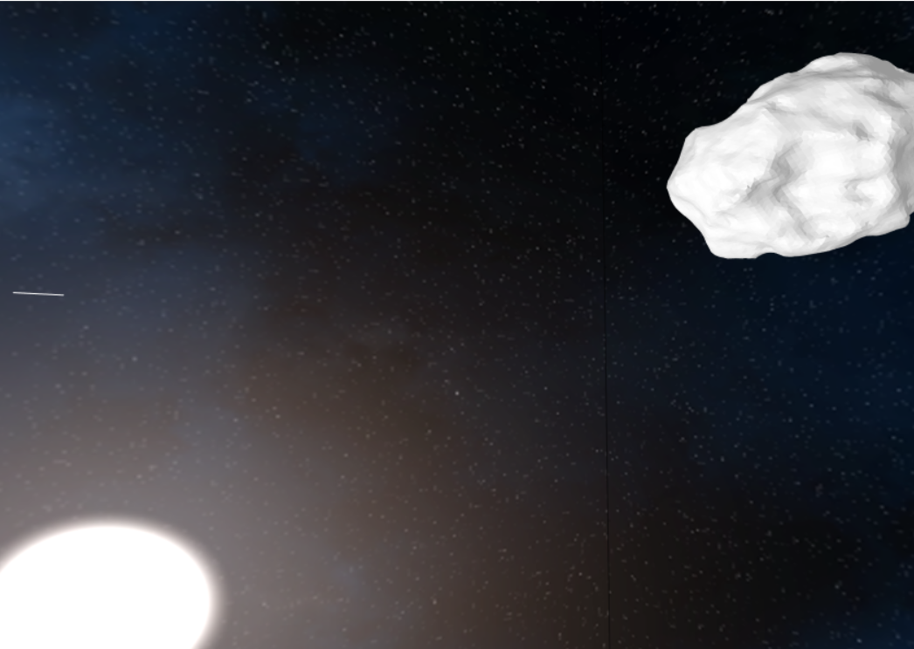
LIGHTING
Legacy OpenGL only supports ambient, diffuse lights
Thus Phong Model of shading is not usable
Only Ambient and Diffuse lights are use by initializing light sources (At max 8) with positions and their colours and intensity
Light can be enabled by :glEnable(GL_LIGHTING);

Slide 18
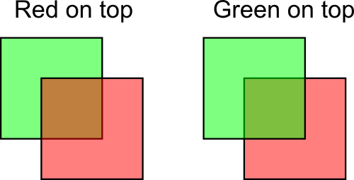
BLENDING AND DEPTH TESTING
Blending is enabled via: glEnable(GL_BLEND); Depth testing enabled via: glEnable(GL_DEPTH_TEST);
Depth testing is Z-buffer test, buffer size can be set beforehand
Blending is done for having proper transparency or translucency features
Depth testing is thus important for blending
glBlendFunc();

Slide 19
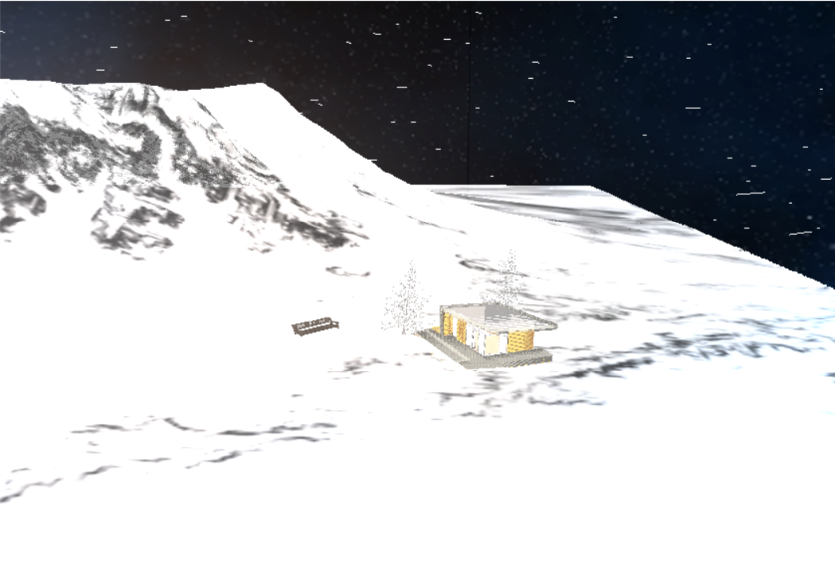
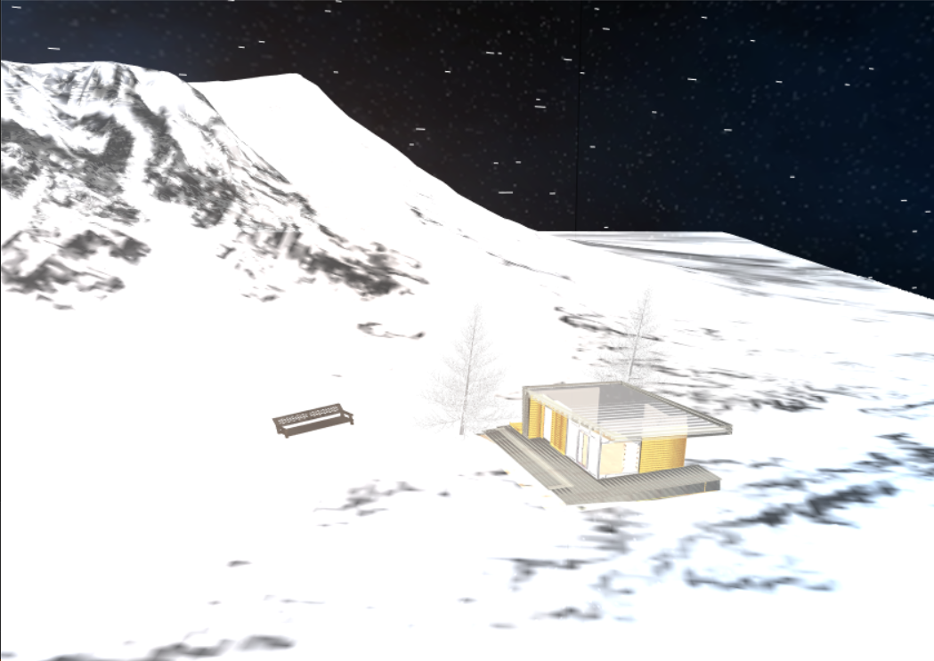
ANTI-ALIASING
MultiSample Anti Aliasing removes problem of jaggy images
Aliasing occurs sometimes because of sampling, sometime because texture image is larger than pixels to map it
Multi Sample Anti Aliasing – A no of samples at the points of each edges takes, and final vertex or texture colour at that point will be the average of all the samples
Reduces jagging images but requires performance power
Sa
SDL_GL_SetAttribute(SDL_GL_MULTISAMPLEBUFFERS,1); SDL_GL_SetAttribute(SDL_GL_MULTISAMPLESAMPLES,16);
19

Slide 20
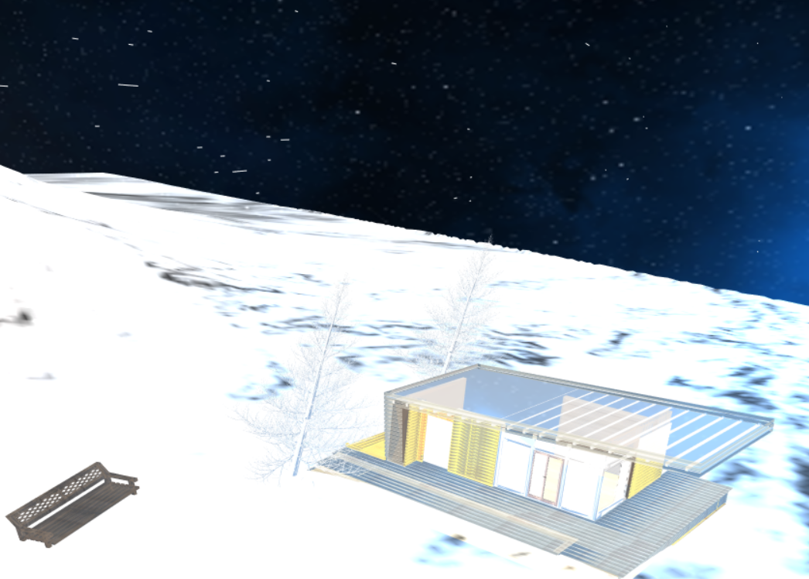
Quote and Image Slide
“
RESULT
20

Slide 21
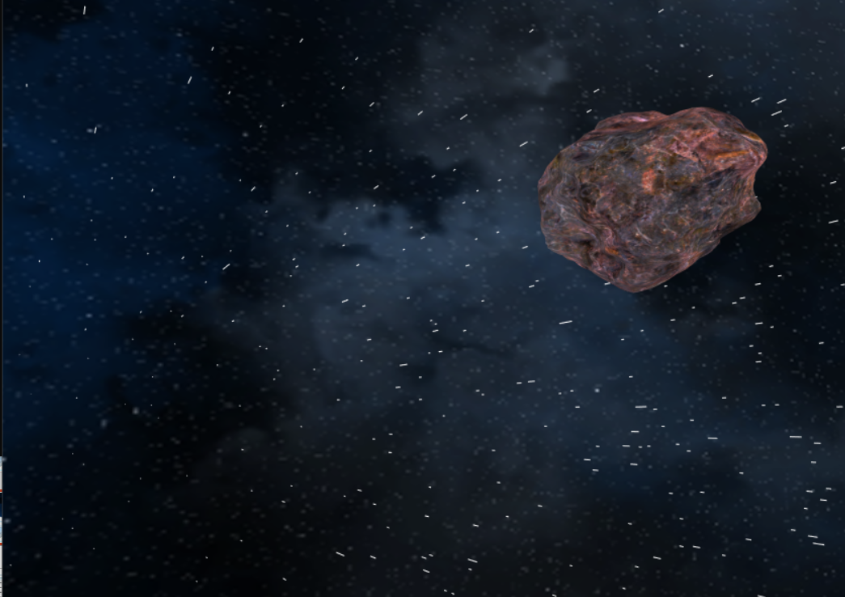
Quote and Image Slide
“
RESULT
21

Slide 22
ADVANTAGES
Compatibility will almost all Computers that can run OpenGL , almost all versions
Easier to code and thus debug
Beginners friendly
No need to write shaders for Lightings and rendering, makes the process faster and easier
22

Slide 23
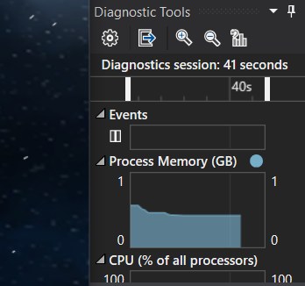
LIMITATIONS
Requires a huge processing power
Phong Illumination Model is not possible
No vertices buffers thus performance suffers
Easier to implement but doesn’t provide full customizations
23

Slide 24
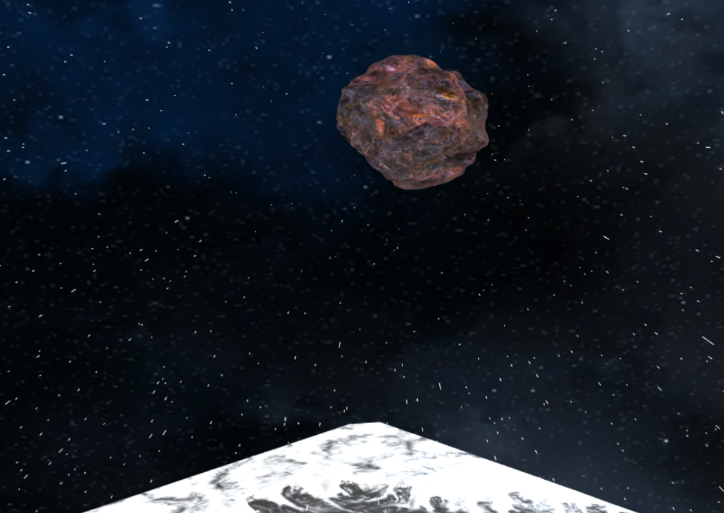
THANK YOU
Insert Image

